Slide 1
Confounding
Week 4, Computational Genomics

Slide 2
Genomics: large number of variables profiled
Gene A expression Gene A Mutation Gene B Mutation Subtype
Sample 1
Sample 2
Sample 3
...
Notes:
So far, in our analysis, we have only looked at a few variables at once. Could they interact with each other, but we don’t realize what is going on?

Slide 3
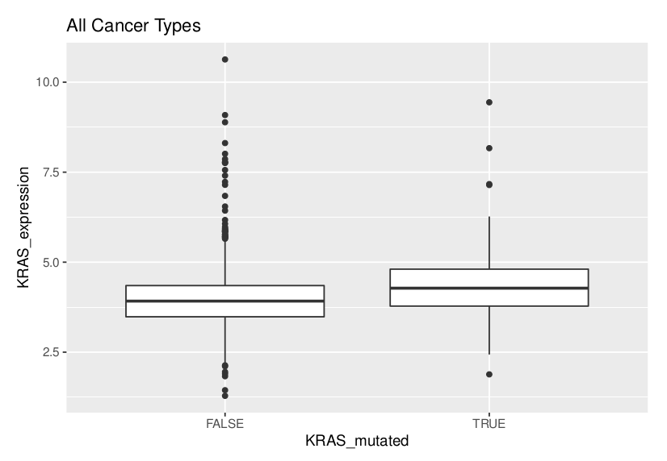
What other variables can explain this trend?
Notes:
This question in last week’s homework is to get us thinking about whether a trend holds up if we break it down by other variables. Maybe this relationship only holds for certain subtypes of cancer.
What other variables we might want to break this up into?
Vocab:

Slide 4
Copy number may explain the association instead
CN = 3?
CN = 2?
Notes:
maybe KRAS mutant with higher KRAS expression is not true at all when broken out into CN.
maybe KRAS mutant with higher KRAS expression is only true in one cancer subtype.

Slide 5
Confounding variable: a variable that is associated with the dependent variable that also overlaps with the independent variable, so that the independent variable association with the dependent variable is less interesting.
“We controlled for variable Z, and saw that the association between Y and X is confounded by variable Z.”
Ie: “We controlled for subtype, and saw that the association between expression and mutation is confounded by subtype. Only lung cancer had this association.”

Slide 6
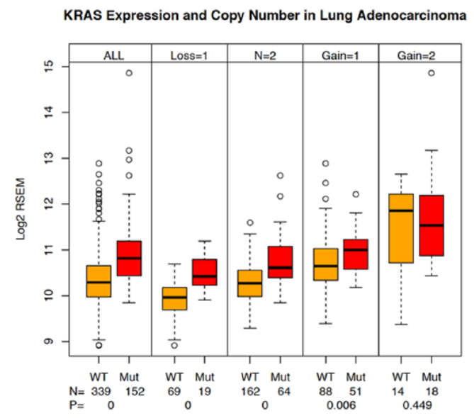
MT/WT trend positively, even when controlled by CN.
CN trend positively, even when controlled by MT/WT.
Notes:
The authors of the paper were worried that the effect that they saw could be explained by CN.
In particular, if CN is associated with inc. expression, and MT/WT is not, then this association is a lot less biologically interesting.
Instead, they show that when they rerun the analysis by fixing the CN for each analysis, they still see a significant result from MT/WT association!
Also, CN is associated with higher gene expression as well, and even when broken out by MT/WT status. But this is maybe less biologically interesting.

Slide 7
MT/WT trend positively, but did not when controlled by CN.
CN trend positively, even when controlled by MT/WT.
Notes:
What would the plot look like if CN actually confounded the association of MT/WT?
Within each group, there wouldn’t be an MT/WT association, and as CN increases, expression increases. CN explains the association, not WT/MT.

Slide 8
MT/WT trend positively, and mostly when controlled by CN.
CN trend positively, and mostly when controlled by MT/WT.
When controlled for a confounding variable, the effect held up on average.

Slide 9
MT/WT trend positively, but CN alterations are only in MT groups.
CN trend positively, but MT is only in CN altered groups.
When controlled for a confounding variable, there wasn’t enough overlap between two variables.

Slide 10
CN = 1, 3, 4

Slide 11
When controlled by subtype, the trend shows different effects.
Subtype y?
Subtype x?
Subtype y?
Subtype x?

Slide 12
Simpson’s paradox: when controlled, the effect flips completely.
Notes:
Image: Wikipedia for simpson’s paradox

Slide 13
What to control?
Subtype
KRAS4A/KRAS4b isoforms (Fig. 1B)
Copy number variation (Fig. 4)
EGFR mutation status (Fig 5a)
We can control for “everything”, but the sample size decreases in each group, and some variables are problem-specific.

Slide 14
Experimental setup to deal with confounding
Observational studies
Case-control studies
Matching
Randomized trials
Notes:
From easiest to hardest, in physical implementation
subgroup analysis, regression

